Slide 1
Presentation Design Showcase

Slide 2
Who we work with

Slide 4
Notes:
FY22 – We conquered Covid and brought growth back.

Slide 5
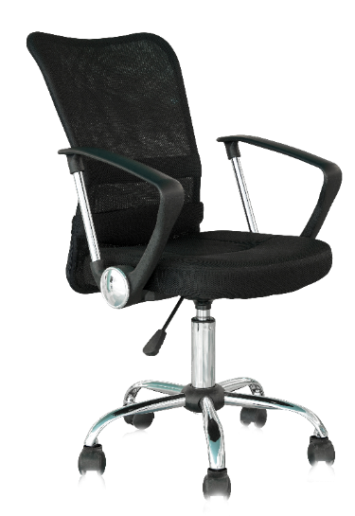
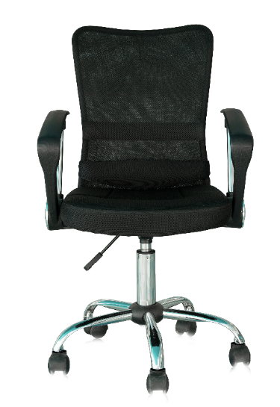
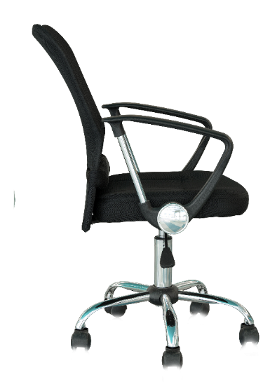

Slide 7
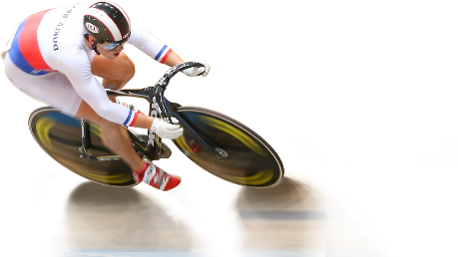
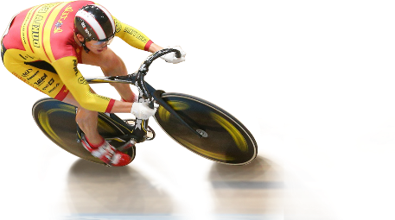
Powering the
BREAK
AWAY
Enterprise

Slide 8
Run rate of
Market cap of over
₹1 Tn
Acquisitions
Seven
ESG rating by MSCI
AA
$2 Bn
Notes:
Fantastic journey and history books would only remember this
Journey from $820 million to 2B$+ company this year
CAGR for Indian IT industry since FY17: 7.5%
LTI CAGR ~ 14%
Even in Covid last year, we grew 9.5%

Slide 9
LARGE + MID + SMALL
500 CLOCK UNIVERSE: NIFTY500
Exclude stocks which may destroy value
High leverage••
Excessive volatility in stock prices
Companies with accounting and governance red flags
Companies showing poor growth or disrupted business models
Exclude stocks which are excessively valued relative to benchmarks
Current stock valuation (P/B) is benchmarked to long term sector averages
Benchmarking factors in company specific fundamentals like profitability, growth and marketcap
Based on a proprietary multivariate regression based valuation model
Select from remaining list by scoring stocks based on:
Profitability (high RoE)
Stable earnings growth
Favorable growth prospects
Dividend paying
Positive free cash flow generation
ELIMINATE POOR QUALITY
VALUATION FILTERS
Research team inputs taken on stocks that pass all above criteria
To avoid value traps
X To avoid cyclical companies at peak earnings
ELIMINATE POOR QUALITY
SELECTION CRITERIA
Fundamental Inputs
SELECT GOOD COMPANIES
FINAL SELECTION

Slide 10
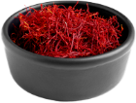
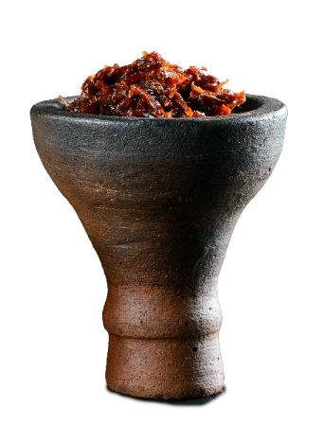
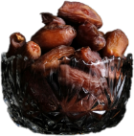
A mixed flavour territory
Universal Flavour space
Accentuated with the recent modernization of the culture and Saudis willingness to indulge in new experiences
Traditional Flavour space
Fruity
Menthol/ fresh
Spicy/Warm
Floral/ Aromatic
Strawberry, Mango, Orange, Fruit cocktail
Mint
Chilli, Ginger, Cloves
Cardamom, Saffron, Rose, Orange blossom
Creamy/Sweet
Exotic
Very sweet
Nutty
Vanilla, Coffee, Custard, Chocolate
Coconut, Passion fruit
Dates, Honey
Pistachio, Almonds, Cashew
Flavour space coverage within Nic category
Wide coverage within Shisha and Vaping
Rare to nonexistent coverage

Slide 12
How ElectriFuel’s
Solutions Work?
Hardware Solutions
Software Solutions
Battery Management System
App Mobile & Web
EV 2 wheeler,
3 Wheeler or Energy Storage Batteries
Cloud
Telematics / IoT Module
APIs

Slide 13
Get Ready For Your
Moment of Clarity!!!

Slide 14
Falca
An Alternative Market Place For Small Holder Farmers
F-ADVISORY
F-HIRE
F-MARKET
F-SHOP
F-STORAGE

Slide 15
Taking Market To The Farmers
Convenience
APMC
5-10 Km vs 30-40 km
25 km
Clarity
Open and Fair Systems
45 km
3 km
Cash
One day Vs 7-30 Days
10 km
Choice
Must Sell vs Option to Decide
Rural Service Point (RSP)

Slide 17
Tower C

Slide 29
EXPERIENCE
22+ years of impactful presentation designs
High-quality presentations within 48 working hours
SPEED
Top-notch designs that stand out from the crowd
QUALITY
REASONS YOU SHOULD HIRE US
Your private data stays confidential. Period.
SECURITY
YOUR BRAND GUIDELINES
We turn ‘constraints’ into design inspiration

Slide 30
Sales PPTs for Enterprises | Financial PPTs | PPTs for fund raising | PPTs for conferences | Investor pitch decks
www.decksherpa.com
1800 121 5955 (India)
+91 99234 44353
contact@decksherpa.com

